Slide 1
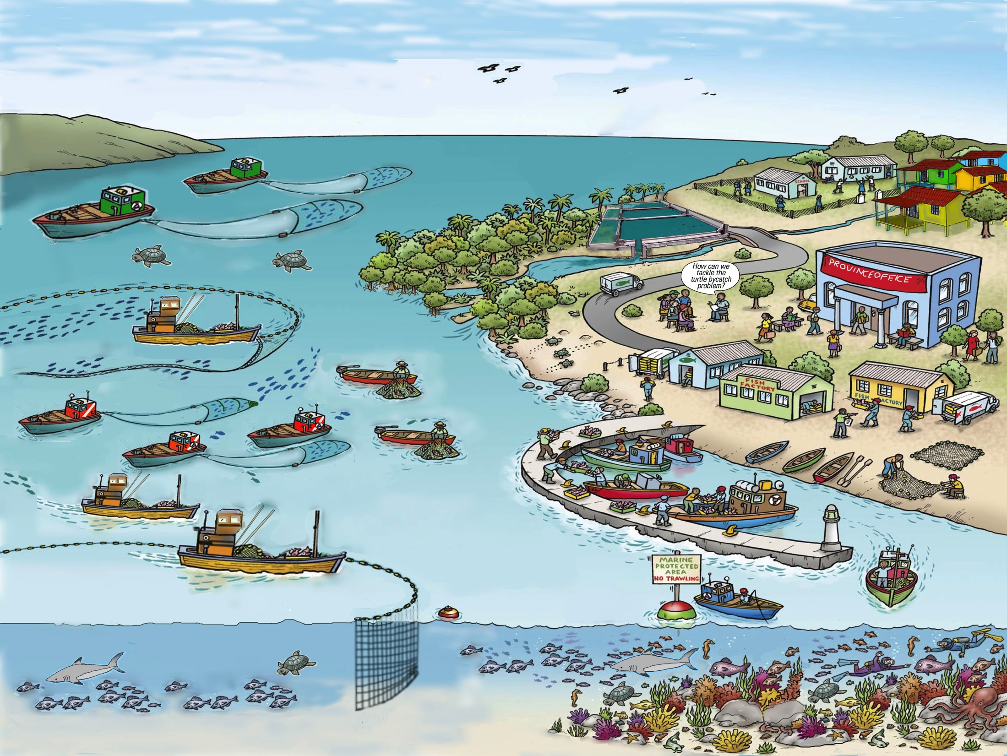
An
Fisheries a Ecosystems… the bigger picture
Source: Adapted from FAO EAF Nansen Project

Slide 2
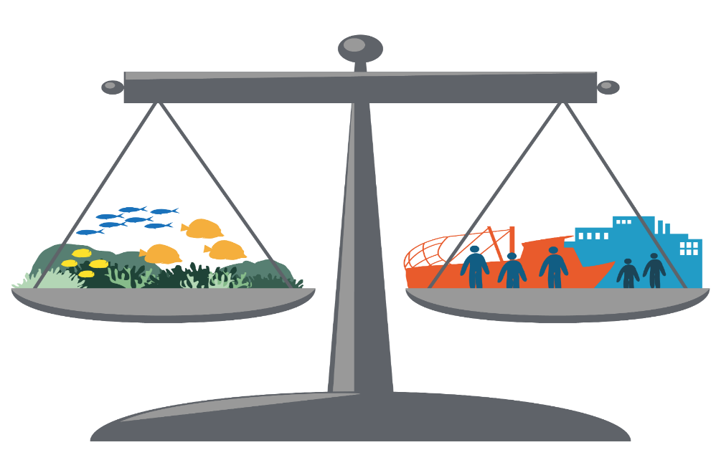
“Development which meets the needs of the present without compromising the ability of future generations to meet their own needs.”
Sustainable Development
GOOD GOVERNANCE
ECOLOGICAL WELL-BEING
HUMAN WELL-BEING
FOR FUTURE GENERATIONS

Slide 3
Key principles of EAFM
1. Good governance
2. Appropriate scale
3. Increased participation
5. Cooperation & coordination
4. Multiple objectives
7. Precautionary approach
6. Adaptive management

Slide 4
Ecological well-being
3 Components of EAFM
EAFM
Human well-being
Good governance
Note: Ecological well-being = fish + environment

Slide 5
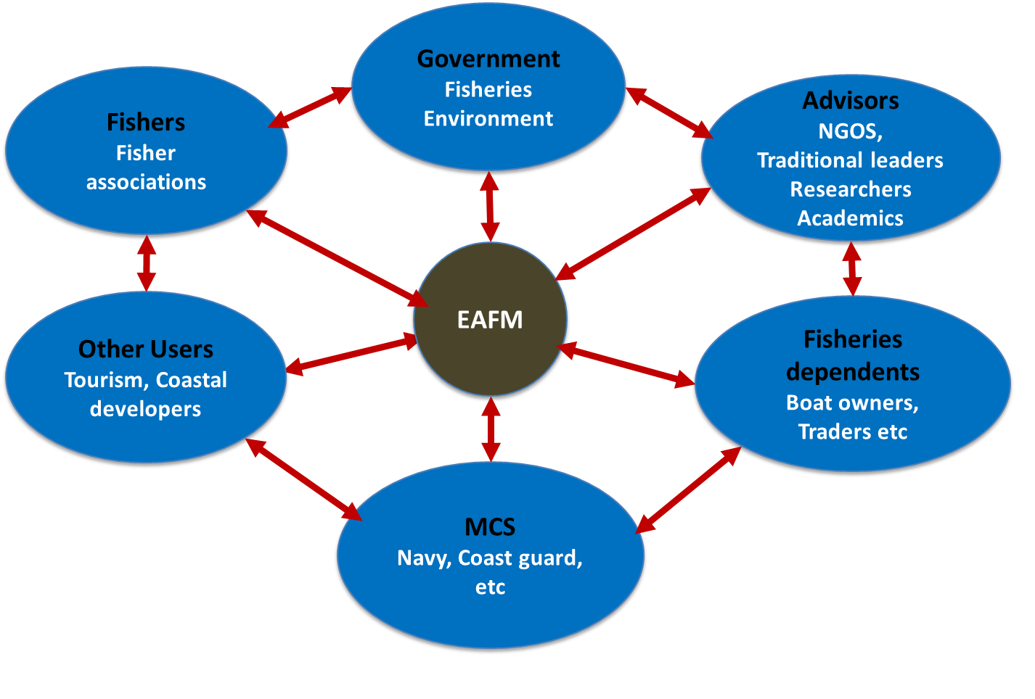
“A stakeholder is any individual, group or organisation who has an interest in or who can affect or is affected by, positively or negatively by the EAFM process”
Who are your stakeholders?

Slide 6
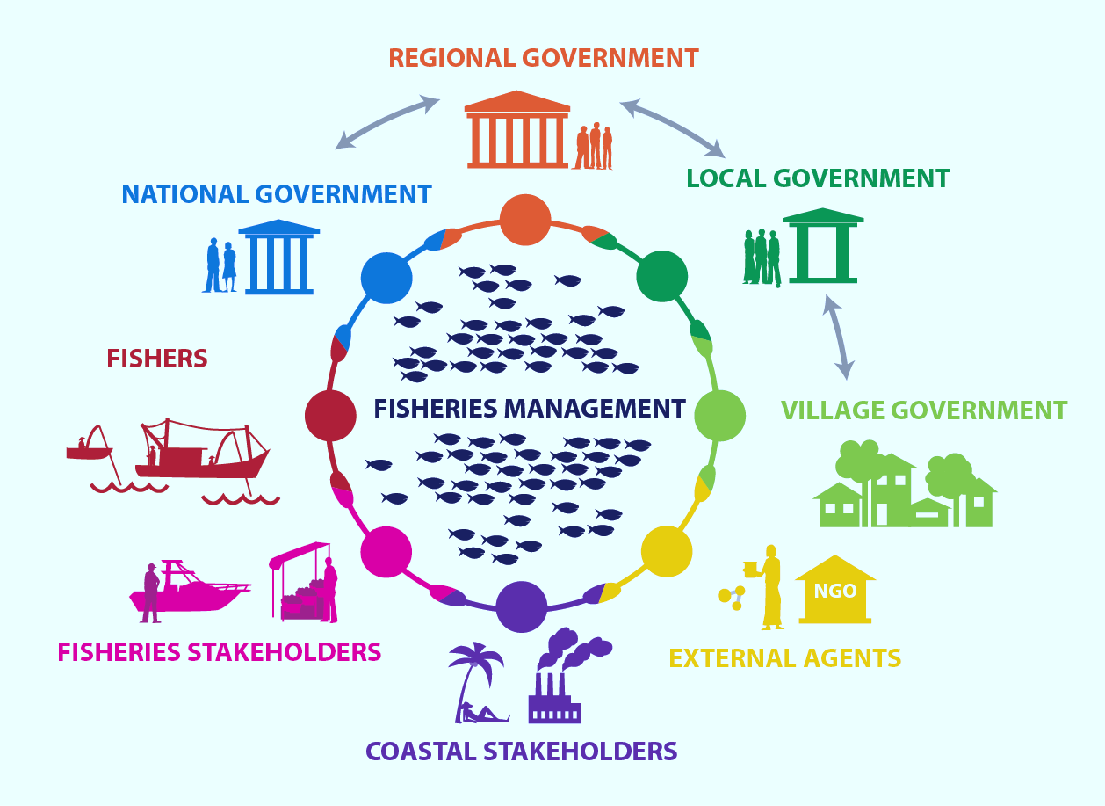
“Partnership arrangements between key stakeholders and government to share the responsibility and authority for the management of the fisheries and coastal resources, with various degrees of power sharing.”
Co-management …

Slide 7
EAFM Plan:
linking legislation & policy to action
Example
Sustainably manage fisheries
Legislation/policy
EAFM PLAN
Limit fishing effort in the trawl fishery
Control number of fishing boats/gears
Management actions

Slide 8
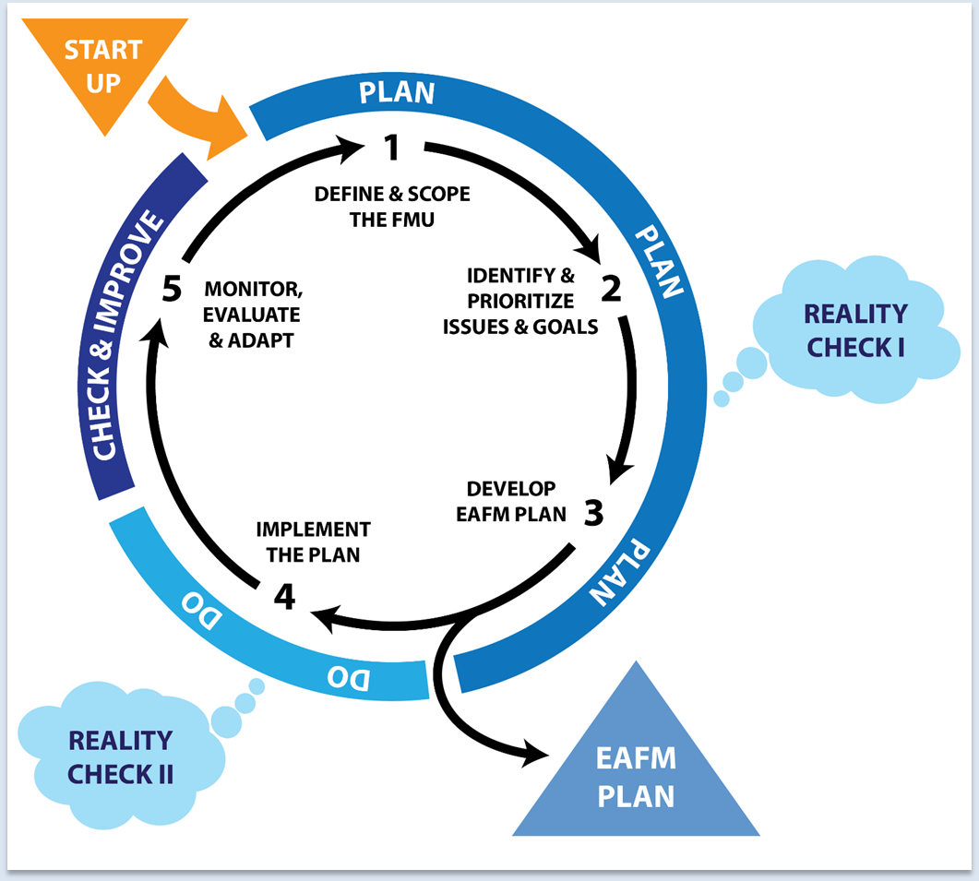
The 5 steps of the EAFM cycle

Slide 9
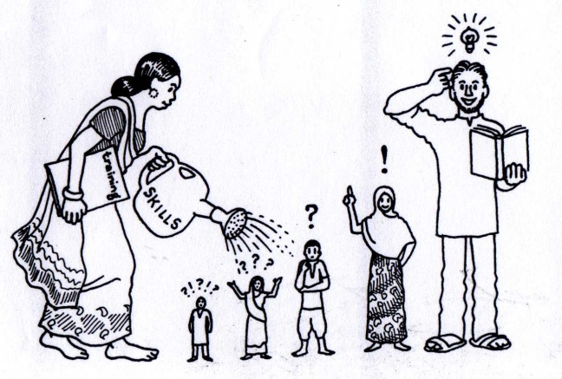
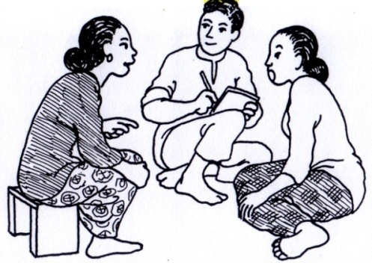
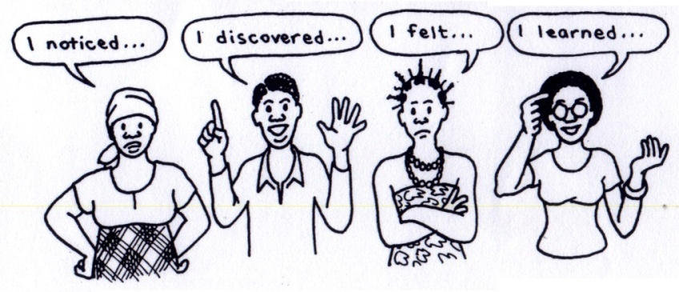
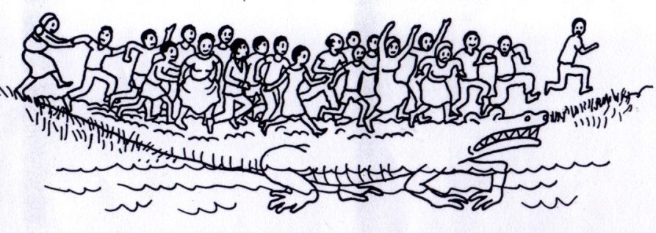
The active PARTICIPATION
of people is at the heart of EAFM
Empowerment
Awareness raising
Agree on issues and solutions
Ownership
Group trust
Notes:
9

Slide 10
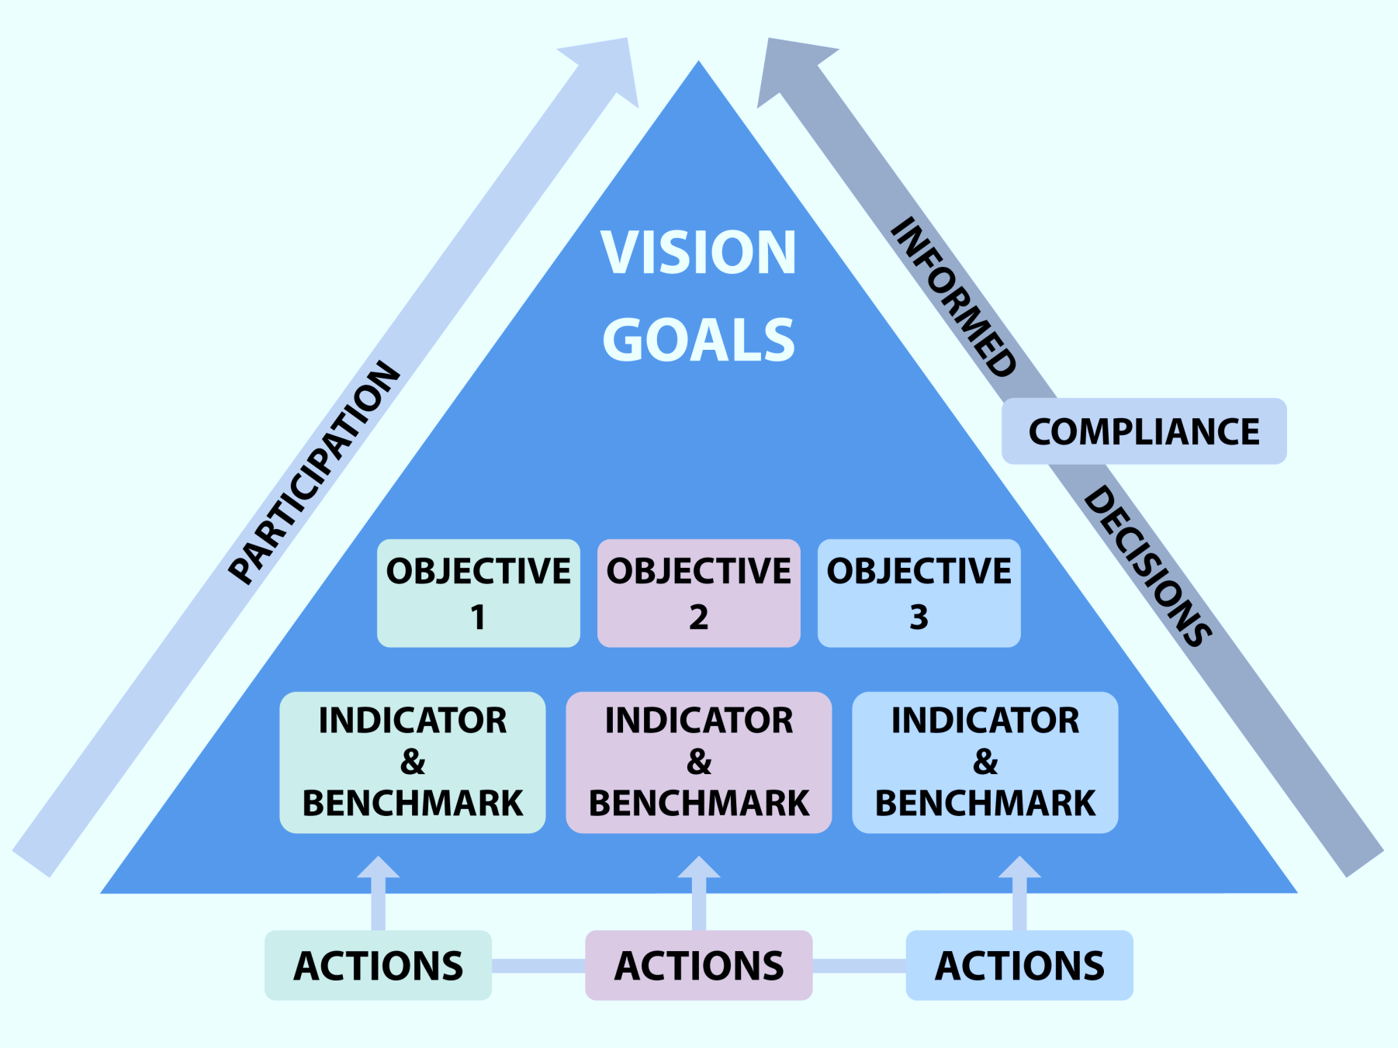
GOAL GOAL
FINANCE
10

Slide 11
EAFM Plan outline
EAFM Management Plan for FMU XX
1. Vision (Step 1)
2. Background (Step 1)
3. Major threats and issues (Step 2)
4. Goals (Step 2)
5. Objectives, indicators and benchmarks (Step 3)
6. Management actions (Step 3)
7. Compliance (Step 3)
8. Data and info needs (Step 3).
9. Financing (Step 3)
10. Review of the plan – frequency of reviews

